Slide 1



Processes
Operating Systems (CS-2006) SPRING 2022, FAST NUCES

Slide 2

ROAD MAP
PROCESS CONCEPT
PROCESS SCHEDULING
OPERATIONS ON PROCESSES
INTERPROCESS COMMUNICATION
EXAMPLES OF IPC SYSTEMS
COMMUNICATION IN CLIENT-SERVER SYSTEMS

Slide 3

PROCESS CONCEPT
An operating system executes a variety of programs:
Batch system – jobs
Time-shared systems – user programs or tasks
Textbook uses the terms job and process almost interchangeably
Process –A process is an instance of a program in execution. Process execution must progress in sequential fashion.
Program is passive entity, process is active
Program becomes process when executable file loaded into memory
Execution of program started via GUI mouse clicks, cmd line etc

Slide 4
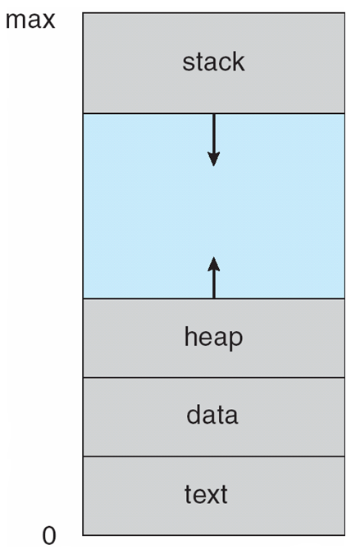
PROCESS IN MEMORY
A process includes:
The program code, also called text section
Current activity including program counter, processor registers
Stack containing temporary data
Function parameters, return addresses, local variables
Data section containing global variables
Heap containing memory dynamically allocated during run time.

Slide 5
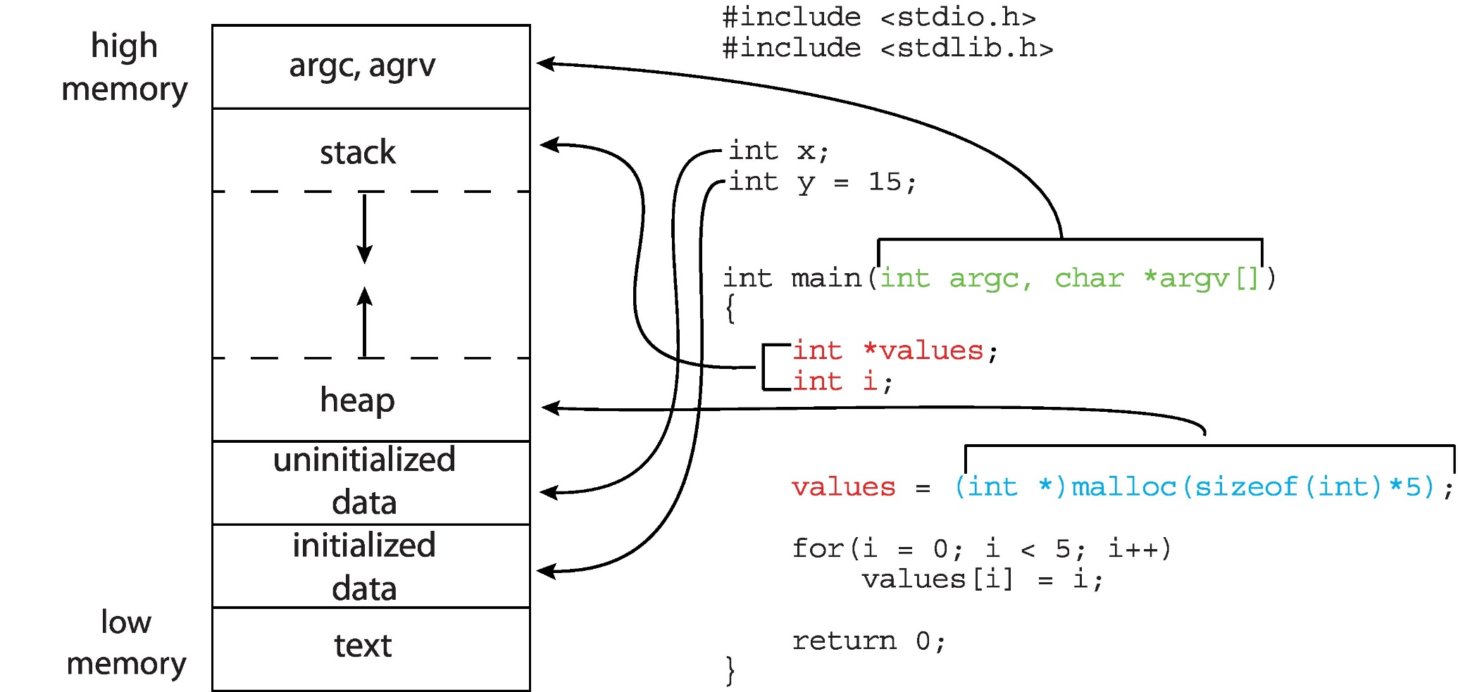
MEMORY LAYOUT OF A C PROGRAM

Slide 6
PROCESS STATE
As a process executes, it changes state
New: the process is being created
Running: instructions are being executed
Waiting: the process is waiting for some event to occur
Ready: the process is waiting to be assigned to a processor
Terminated: the process has finished execution

Slide 7
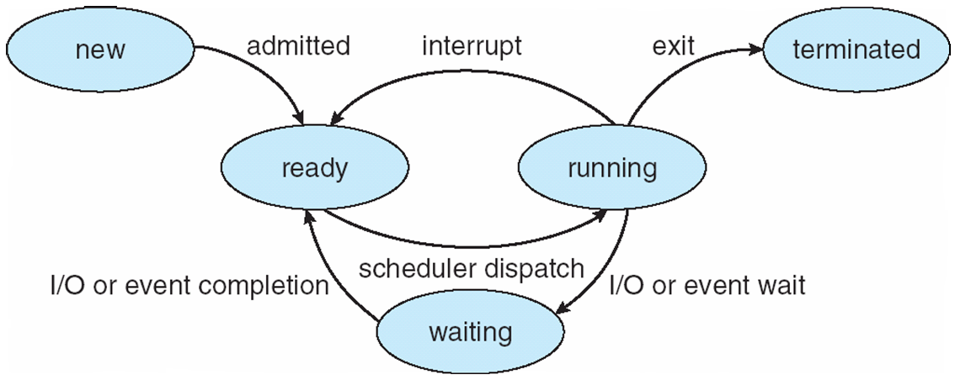
STATE TRANSITION DIAGRAM OF A PROCESS

Slide 8
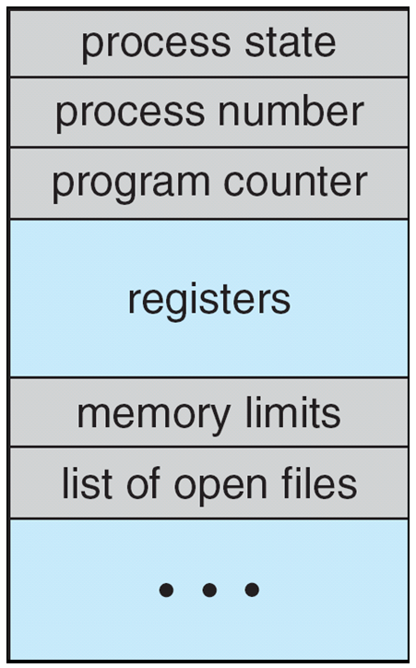
PROCESS CONTROL BLOCK (PCB)
Information associated with each process
(also called TASK CONTROL BLOCK)
Process state – running, waiting, etc.
Process ID, and parent process ID
Program counter – location of instruction to next execute
CPU registers – contents of all process-centric registers. CPU scheduling information- priorities, scheduling queue pointers
Memory-management information – memory allocated to the process
Accounting information – CPU used, clock time elapsed since start, time limits
I/O status information – I/O devices allocated to process, list of open files

Slide 9
PROCESS SCHEDULING
Maximize CPU use, quickly switch processes onto CPU for time sharing
Process scheduler selects among available processes for next execution on CPU and maintains scheduling queues of processes

Slide 10
PROCESS SCHEDULING QUEUES
Ready queue – set of all processes residing in main memory, ready and waiting to execute
Wait queues – set of processes waiting for an I/O device
Processes migrate among the various queues

Slide 11
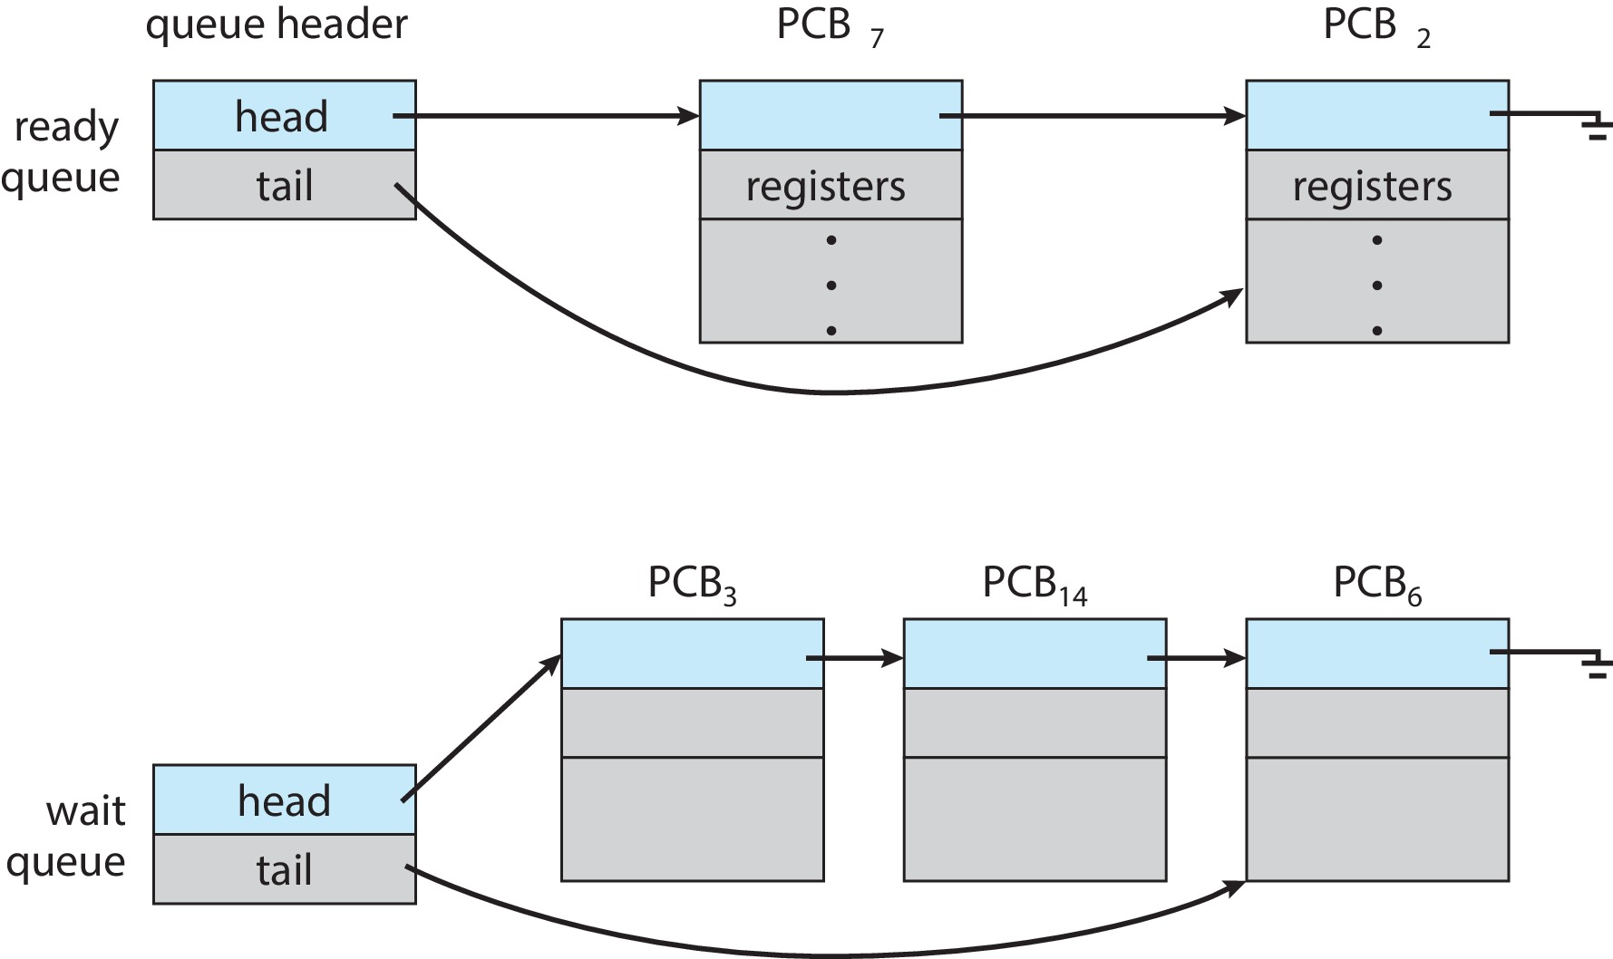
READY AND WAIT QUEUES

Slide 12
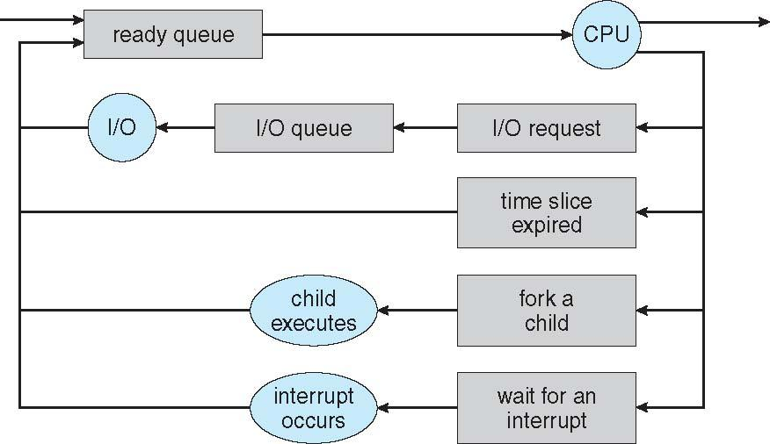
REPRESENTATION OF PROCESS SCHEDULING
Queueing diagram represents queues, resources, flows

Slide 13
SCHEDULERS
Short-term scheduler (or CPU scheduler) – selects which process should be executed next and allocates CPU
Sometimes the only scheduler in a system
Short-term scheduler is invoked frequently (milliseconds) ⇒ (must be fast)
Long-term scheduler (or job scheduler) – selects which processes should be brought into the ready queue
Long-term scheduler is invoked infrequently (seconds, minutes) ⇒ (may be slow)
The long-term scheduler controls the degree of multiprogramming

Slide 14
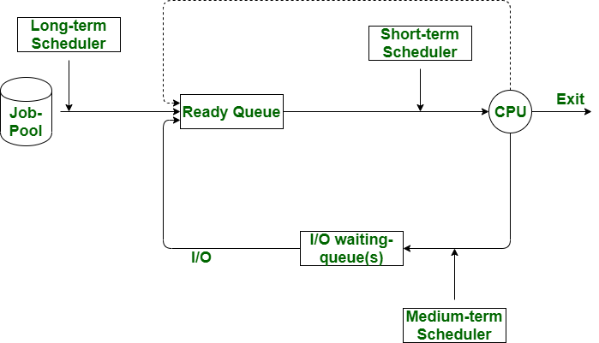
SCHEDULERS

Slide 15
SCHEDULERS
Processes can be described as either:
I/o-bound process – spends more time doing I/O than computations, many short CPU bursts
CPU-bound process – spends more time doing computations; few very long CPU bursts
Long-term scheduler strives for good process mix

Slide 16
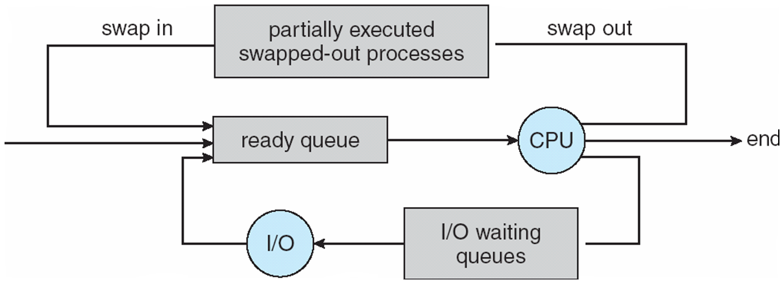
ADDITION OF MEDIUM-TERM SCHEDULING
Medium-term scheduler can be added if degree of multiple programming needs to decrease
Remove process from memory, store on disk, bring back in from disk to continue execution: swapping

Slide 17
MULTITASKING IN MOBILE SYSTEMS
Some mobile systems (e.g., Early version of iOS) allow only one process to run, others suspended
Due to screen real estate, user interface limits iOS provides for a
Single foreground process- controlled via user interface
Multiple background processes– in memory, running, but not on the display, and with limits
Limits include single, short task, receiving notification of events, specific long-running tasks like audio playback
Android runs foreground and background, with fewer limits
Background process uses a service to perform tasks
Service can keep running even if background process is suspended
Service has no user interface, small memory use
Notes:
Screen real estate refers to the space available to design in. ... Screen resolution varies from computer to computer

Slide 18
CONTEXT SWITCH
When CPU switches to another process, the system must save the state of the old process and load the saved state for the new process via a context switch
Context of a process represented in the PCB
Context-switch time is overhead; the system does no useful work while switching

Slide 19
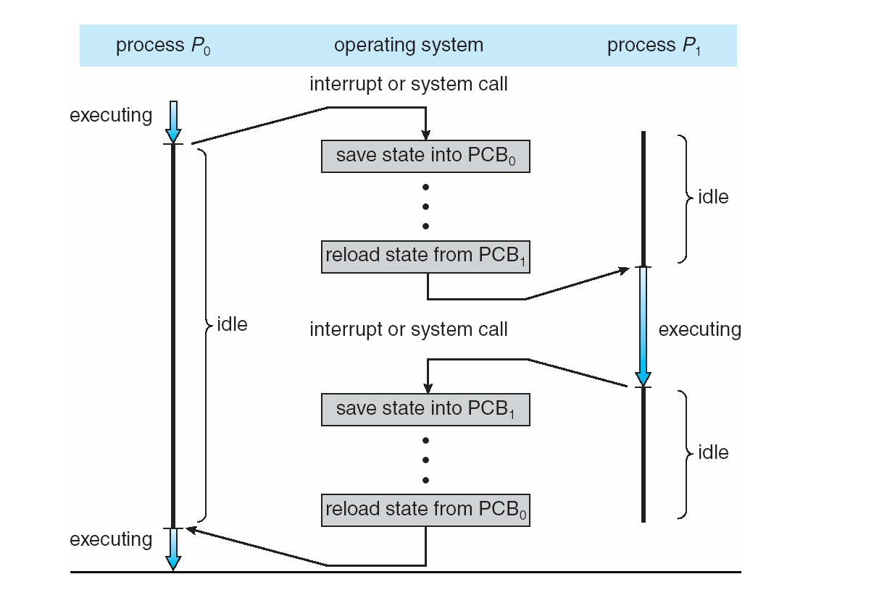
CPU SWITCH FROM PROCESS TO PROCESS

Slide 20
OPERATIONS ON PROCESSES
System must provide mechanisms for:
Process creation,
Process termination,
and so, on as detailed next

Slide 21
PROCESS CREATION
Parent process create children processes, which, in turn create other processes, forming a tree of processes
Generally, process identified and managed via a process identifier (pid)
Resource sharing options
Parent and children share all resources
Children share subset of parent’s resources
Parent and child share no resources
Execution options
Parent and children execute concurrently
Parent waits until children terminate

Slide 22
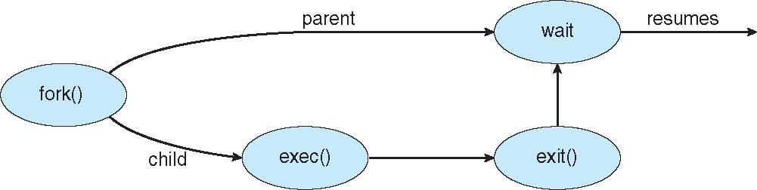
PROCESS CREATION (CONT.)
Address space
Child duplicate of parent
Child has a program loaded into it
UNIX examples
Fork() system call creates new process
Exec() system call used after a fork() to replace the process’ memory space with a new program

Slide 23
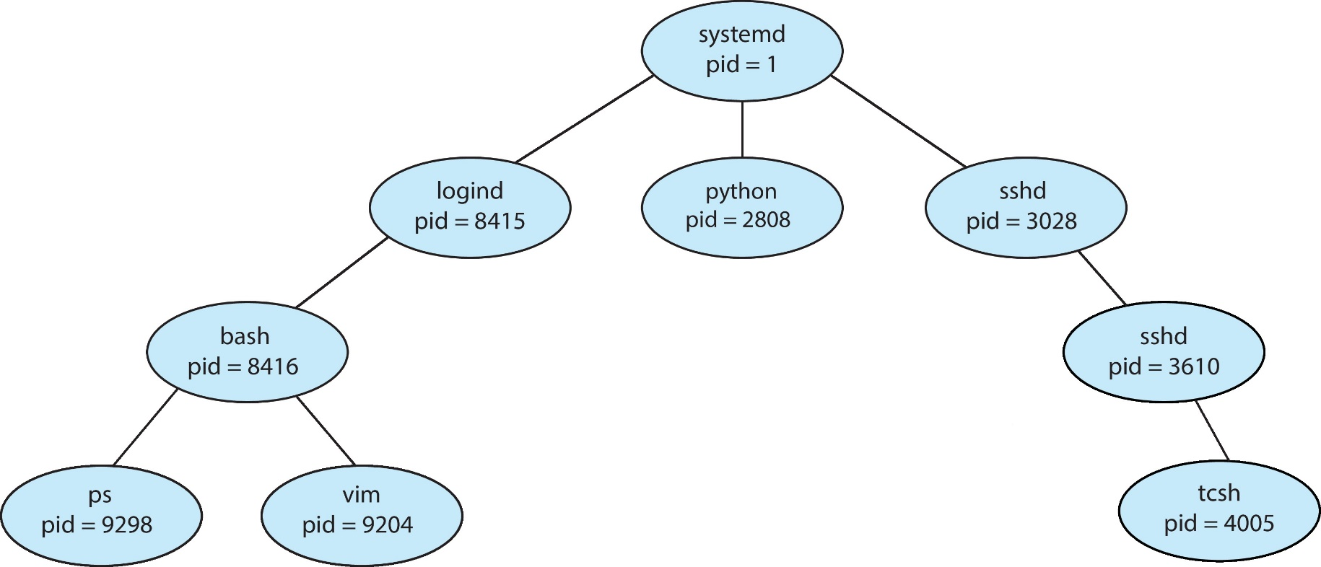
A TREE OF PROCESSES IN LINUX

Slide 24
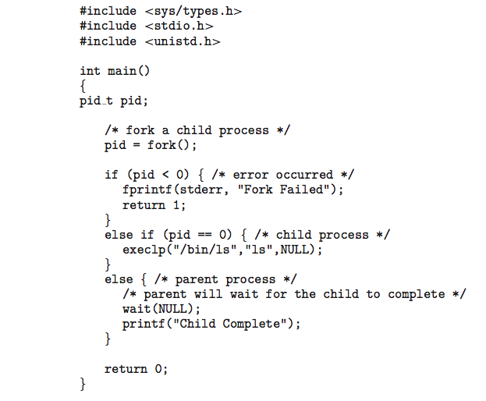
C PROGRAM FORKING SEPARATE PROCESS

Slide 25
PROCESS TERMINATION
Process executes last statement and then asks the operating system to delete it using the exit() system call.
Returns status data from child to parent (via wait())
Process’ resources are DE allocated by operating system
Parent may terminate the execution of children processes using the abort() system call. Some reasons for doing so:
Child has exceeded allocated resources
Task assigned to child is no longer required
The parent is exiting, and the operating systems does not allow a child to continue if its parent terminates
ALL CHILDREN TERMINATED - CASCADING TERMINATION

Slide 26
ANDROID PROCESS IMPORTANCE HIERARCHY
MOBILE OPERATING SYSTEMS OFTEN HAVE TO TERMINATE PROCESSES TO RECLAIM SYSTEM RESOURCES SUCH AS MEMORY.
Process hierarchy FROM MOST TO LEAST IMPORTANT:
FOREGROUND PROCESS
VISIBLE PROCESS
SERVICE PROCESS
BACKGROUND PROCESS
EMPTY PROCESS
ANDROID WILL BEGIN TERMINATING PROCESSES THAT ARE LEAST IMPORTANT.

Slide 27

MULTI PROCESS ARCHITECTURE – CHROME BROWSER
MANY WEB BROWSERS RAN AS SINGLE PROCESS (SOME STILL DO)
IF ONE WEB SITE CAUSES TROUBLE, ENTIRE BROWSER CAN HANG OR CRASH
GOOGLE CHROME BROWSER IS MULTIPROCESS WITH 3 DIFFERENT TYPES OF PROCESSES:
BROWSER PROCESS MANAGES USER INTERFACE, DISK AND NETWORK I/O
RENDERER PROCESS RENDERS WEB PAGES, DEALS WITH HTML, JAVASCRIPT. A NEW RENDERER CREATED FOR EACH WEBSITE OPENED
RUNS IN SANDBOX RESTRICTING DISK AND NETWORK I/O, MINIMIZING EFFECT OF SECURITY EXPLOITS
PLUG-IN PROCESS FOR EACH TYPE OF PLUG-IN

Slide 28
COOPERATING PROCESSES
Independent process cannot affect or be affected by the execution of another process
Cooperating process can affect or be affected by the execution of another process
Advantages of process cooperation
Information sharing
Computation speed-up
Modularity
Convenience

Slide 29
INTERPROCESS COMMUNICATION
Processes within a system may be independent or cooperating
Cooperating process can affect or be affected by other processes, including sharing data
Reasons for cooperating processes:
Information sharing
Computation speedup
Modularity
Convenience
Cooperating processes need interprocess communication (IPC)
Two models of IPC
Shared memory
Message passing

Slide 30
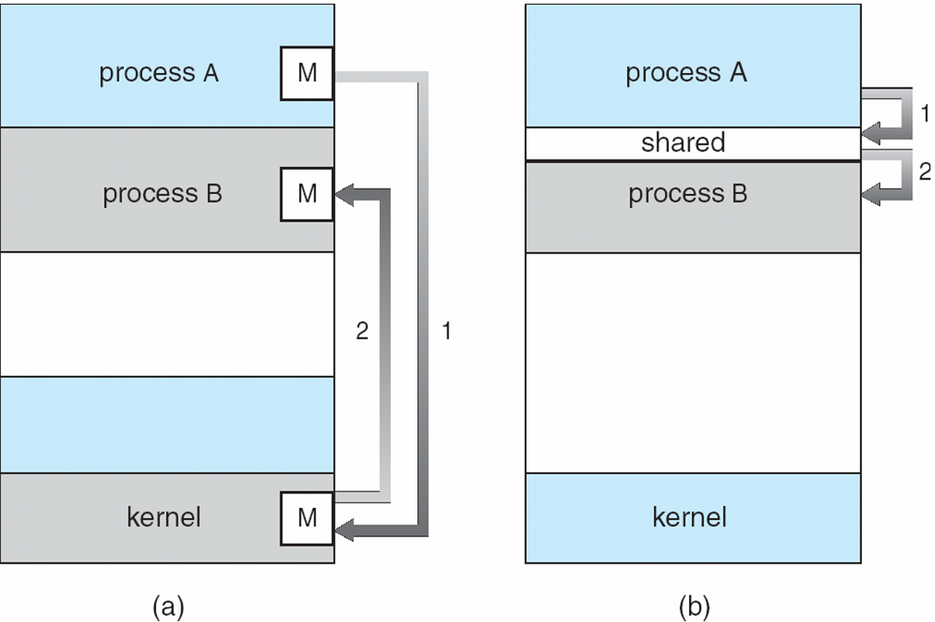
COMMUNICATIONS MODELS
(a) Message passing. (b) shared memory.

Slide 31
PRODUCER-CONSUMER PROBLEM
Paradigm for cooperating processes, producer process produces information that is consumed by a consumer process
Unbounded-buffer places no practical limit on the size of the buffer
Bounded-buffer assumes that there is a fixed buffer size

Slide 32
BOUNDED-BUFFER – SHARED-MEMORY SOLUTION
Shared data
#Define BUFFER_SIZE 10
Typedef struct {
. . .
} item;
Item buffer[buffer_size];
Int in = 0;
Int out = 0;
Solution is correct, but can only use buffer_size-1 elements

Slide 33
BOUNDED-BUFFER – PRODUCER
Item next_produced;
While (true) {
/* produce an item in next produced */
while (((in + 1) % BUFFER_SIZE) == out)
; /* do nothing */
buffer[in] = next_produced;
in = (in + 1) % BUFFER_SIZE;
}

Slide 34
BOUNDED BUFFER – CONSUMER
Item next_consumed;
While (true) { while (in == out)
; /* do nothing */ next_consumed = buffer[out];
out = (out + 1) % BUFFER_SIZE;
/* consume the item in next consumed */
}

Slide 35
EXAMPLES OF IPC SYSTEMS - POSIX
POSIX SHARED MEMORY
Process first creates shared memory segment
SEGMENT ID = SHMGET(IPC PRIVATE, SIZE, S IRUSR | S IWUSR);
Process wanting access to that shared memory must attach to it
SHARED MEMORY = (CHAR *) SHMAT(ID, NULL, 0);
Now the process could write to the shared memory
SPRINTF(SHARED MEMORY, "WRITING TO SHARED MEMORY");
When done a process can detach the shared memory from its address space
SHMDT(SHARED MEMORY);

Slide 36
INTER PROCESS COMMUNICATION – MESSAGE PASSING
Mechanism for processes to communicate and to synchronize their actions
Message system – processes communicate with each other without resorting to shared variables
IPC facility provides two operations:
Send(message)
Receive(message)
The message size is either fixed or variable

Slide 37
MESSAGE PASSING (CONT.)
If processes P and Q wish to communicate, they need to:
Establish a communication link between them
Exchange messages via send/receive.
Implementation issues:
How are links established?
Can a link be associated with more than two processes?
How many links can there be between every pair of communicating processes?
What is the capacity of a link?
Is the size of a message that the link can accommodate fixed or variable?
Is a link unidirectional or bi-directional?

Slide 38
MESSAGE PASSING (CONT.)
Implementation of communication link:
Physical:
Shared memory
Hardware bus
Network
Logical:
Direct or indirect
Synchronous or asynchronous
Automatic or explicit buffering

Slide 39
DIRECT COMMUNICATION
Processes must name each other explicitly:
Send (P, message) – send a message to process P
Receive(q, message) – receive a message from process Q
Properties of communication link
Links are established automatically
A link is associated with exactly one pair of communicating processes
Between each pair there exists exactly one link
The link may be unidirectional, but is usually bi-directional

Slide 40
INDIRECT COMMUNICATION
Messages are directed and received from mailboxes (also referred to as ports)
Each mailbox has a unique id
Processes can communicate only if they share a mailbox
Properties of communication link
Link established only if processes share a common mailbox
A link may be associated with many processes
Each pair of processes may share several communication links
Link may be unidirectional or bi-directional

Slide 41
INDIRECT COMMUNICATION
Operations
Create a new mailbox (port)
Send and receive messages through mailbox
Destroy a mailbox
Primitives are defined as:
Send(a, message) – send a message to mailbox A
Receive(a, message) – receive a message from mailbox A

Slide 42
INDIRECT COMMUNICATION
Mailbox sharing
P₁, P₂, and P₃ share mailbox A
P₁, sends; P₂ and P₃ receive
Who gets the message?
Solutions
Allow a link to be associated with at most two processes
Allow only one process at a time to execute a receive operation
Allow the system to select arbitrarily the receiver. Sender is notified who the receiver was.

Slide 43
SYNCHRONIZATION
Message passing may be either blocking or non-blocking
Blocking is considered synchronous
Blocking send -- the sender is blocked until the message is received
Blocking receive -- the receiver is blocked until a message is available
Non-blocking is considered asynchronous
Non-blocking send -- the sender sends the message and continue
Non-blocking receive -- the receiver receives:
A valid message, or
null message
Different combinations possible
If both send and receive are blocking, we have a rendezvous

Slide 44
SYNCHRONIZATION (CONT.)
PRODUCER-CONSUMER BECOMES TRIVIAL
MESSAGE NEXT_PRODUCED;
WHILE (TRUE) { /* PRODUCE AN ITEM IN NEXT PRODUCED */
SEND(NEXT_PRODUCED);
}
message next_consumed;
while (true) {
receive(next_consumed);
/* consume the item in next consumed */
}

Slide 45
BUFFERING
Queue of messages attached to the link.
Implemented in one of three ways
1. Zero capacity – no messages are queued on a link. Sender must wait for receiver (rendezvous)
2. Bounded capacity – finite length of n messages sender must wait if link full
3. Unbounded capacity – infinite length sender never waits

Slide 46
EXAMPLES OF IPC SYSTEMS - MACH
Mach communication is message based
Even system calls are messages
Each task gets two mailboxes at creation- kernel and notify
Only three system calls needed for message transfer
Msg_send(), msg_receive(), msg_rpc()
Mailboxes needed for communication , created via
Port_allocate()
Send and receive are flexible, for example four options if mailbox full:
Wait indefinitely
Wait at most n milliseconds
Return immediately
Temporarily cache a message

Slide 47
EXAMPLES OF IPC SYSTEMS – WINDOWS
Message-passing centric via advanced local procedure call (LPC) facility
Only works between processes on the same system
Uses ports (like mailboxes) to establish and maintain communication channels
Communication works as follows:
The client opens a handle to the subsystem’s connection port object.
The client sends a connection request.
The server creates two private communication ports and returns the handle to one of them to the client.
The client and server use the corresponding port handle to send messages or callbacks and to listen for replies.

Slide 48
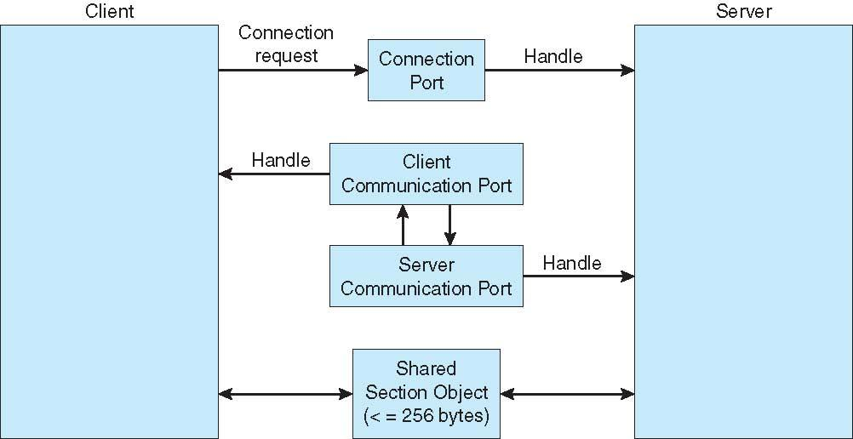
LOCAL PROCEDURE CALLS IN WINDOWS

Slide 49
COMMUNICATIONS IN CLIENT-SERVER SYSTEMS
Sockets
Remote procedure calls
Pipes

Slide 50
SOCKETS
A socket is defined as an endpoint for communication
Concatenation of IP address and port – a number included at start of message packet to differentiate network services on a host
The socket 161.25.19.8:1625 refers to port 1625 on host 161.25.19.8
Communication consists between a pair of sockets
All ports below 1024 are well known, used for standard services
Special ip address 127.0.0.1 (loopback) to refer to system on which process is running

Slide 51
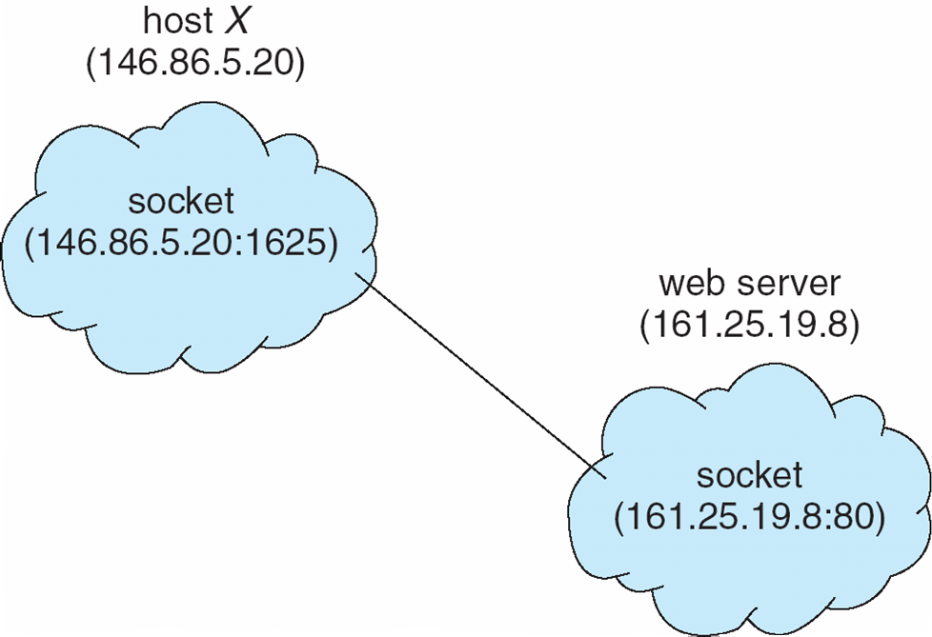
SOCKET COMMUNICATION

Slide 52
REMOTE PROCEDURE CALLS
Remote procedure call (RPC) abstracts procedure calls between processes on networked systems
Again uses ports for service differentiation
Stubs – client-side proxy for the actual procedure on the server
The client-side stub locates the server and Marshalls the parameters
The server-side stub receives this message, unpacks the marshalled parameters, and performs the procedure on the server

Slide 53
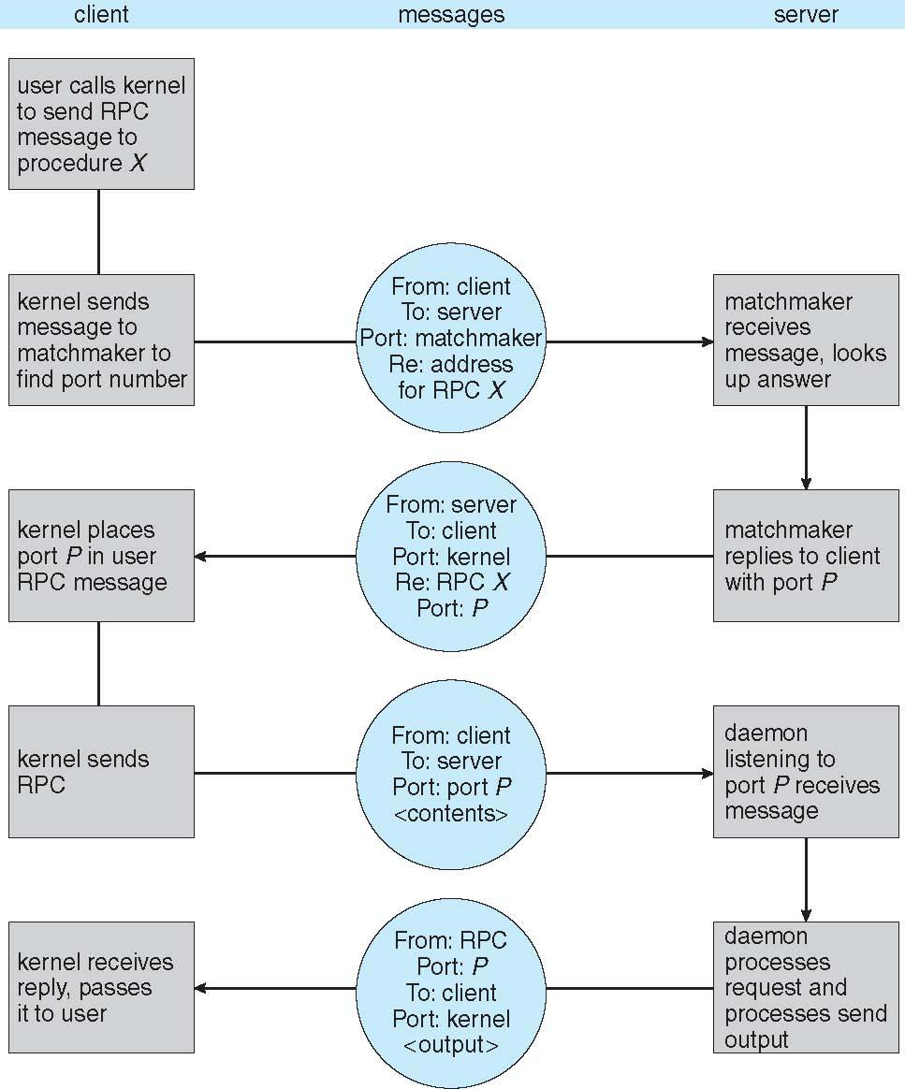
EXECUTION OF RPC

Slide 54
PIPES
Acts as a conduit allowing two processes to communicate
Issues:
Is communication unidirectional or bidirectional?
In the case of two-way communication, is it half or full-duplex?
Must there exist a relationship ( i.e., Parent-child) between the communicating processes?
Can the pipes be used over a network?.

Slide 55
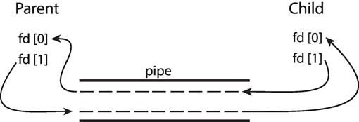
ORDINARY PIPES
Ordinary pipes allow communication in standard producer-consumer style.
Producer writes to one end (the write-end of the pipe).
Consumer reads from the other end (the read-end of the pipe).
Ordinary pipes are therefore unidirectional.
Require parent-child relationship between communicating processes.
WINDOWS CALLS THESE ANONYMOUS PIPES

Slide 56
NAMED PIPES
Named pipes are more powerful than ordinary pipes
Communication is bidirectional
No parent-child relationship is necessary between the communicating processes
Several processes can use the named pipe for communication
Provided on both UNIX and windows systems

Slide 57
THANK YOU!

